Slide 1
Analysis & Visualization
George Netscher, Qiyu Peng

Slide 2
User collects data
Binary list mode data file + text header file
Data analysis functions
File report structure
Data visualization functions
User interface

Slide 3
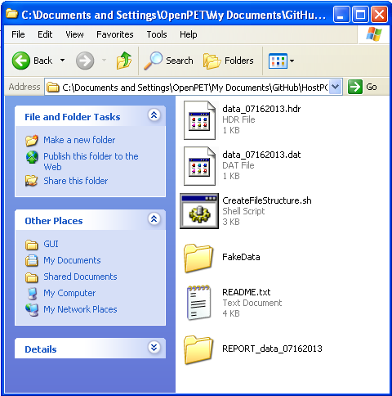
Data Analysis
User collects data
Binary list mode data file + text header file
Data analysis functions
File report structure

Slide 4
Walkthrough

Slide 5
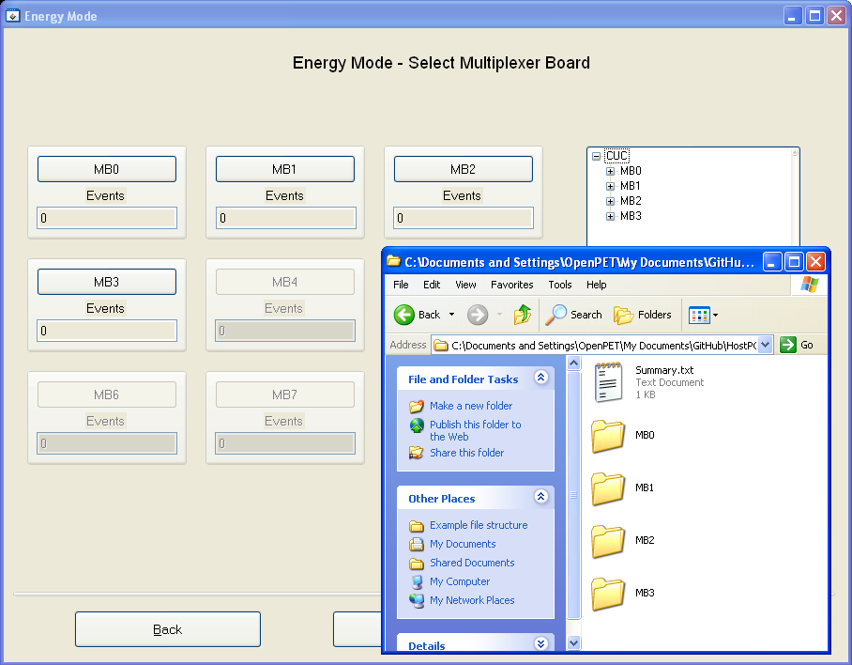
Data Visualization
Data analysis functions
File report structure
Data visualization functions
User interface

Slide 6
Walkthrough

Slide 7
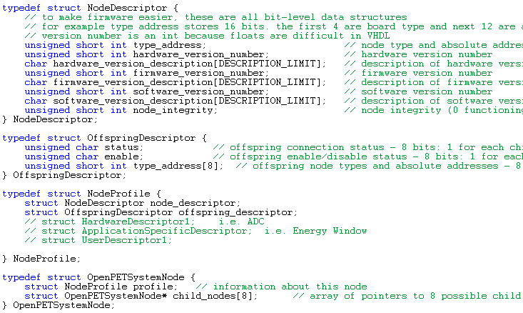
Requires knowledge of System Configuration

Slide 8
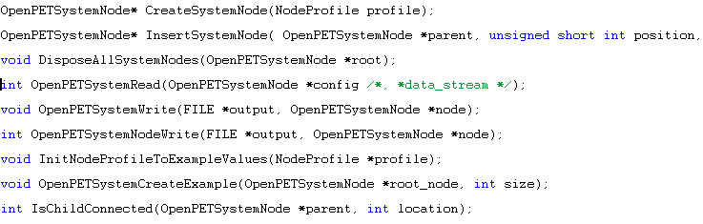
And methods to access system configuration

